Slide 1

acknowledgment
We acknowledge the Bundjalung, Gumbaynggirr and Yaegl people as the Traditional Owners of the land on which we all live and work. We honour the First Nations peoples culture & connection to land, sea and community.
We pay our respects to their Elders past, present and emerging.

Slide 2
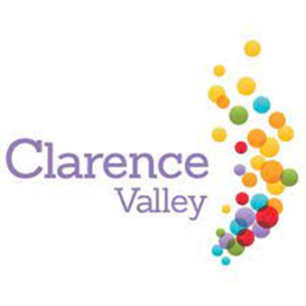
Economic
Development & Tourism
Advisory Committee
02 Aug 2022

Slide 3
Aim
To provide the Economic Development and Tourism Advisory Committee (EDTAC) with and introduction brief on the Industry Engagement and Tourism capabilities within the CCI Team.

Slide 4
Scope of the Presentation
Structure of Communication & Industry Engagement (CIE) section.
Background and Strategies.

Slide 5
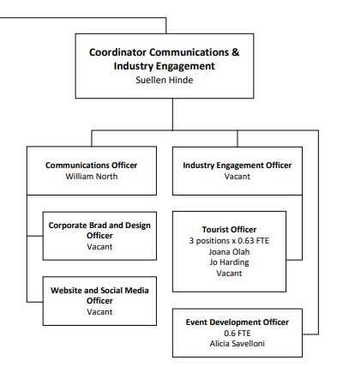
Communications and Industry Engagement section

Slide 6
Industry Engagement Capability
Staffing
The Industry Engagement section comprises of two staff. One fulltime Industry Engagement Officer, who is also the supervisor of the Tourism Staff and the other a part time Event Development Officer
The Industry Engagement section report to the Coordinator Communications and Industry Engagement. These staff deliver:
  Event development and coordination,
  Coordinate event sponsorship,
  Sector coordination and engagement and with Other regional agencies.
Annual Operating Budget FY 21/22 ($591,985)
Wages - $290,660
Operating - $301,325

Slide 7
Tourism Officer Capability
Staffing
The tourism section is part of the Communications and Industry Engagement Team.
The tourism section comprises of three part-time (0.63 FTEW) staff who deliver:
  The accredited Visitor Information Centre services,
  All the online marketing and social media, and
  Sector coordination and engagement.
  Provide administration support to information hubs and operators.
Annual Operating Budget FY 21/22 ($273,487)
Operating - $216,287 (wages $ 126,372)
Marketing - $57,200

Slide 8
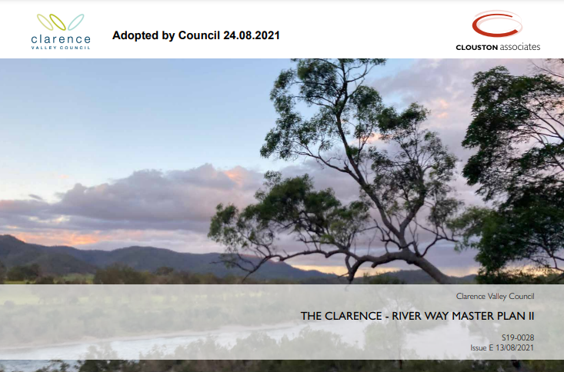
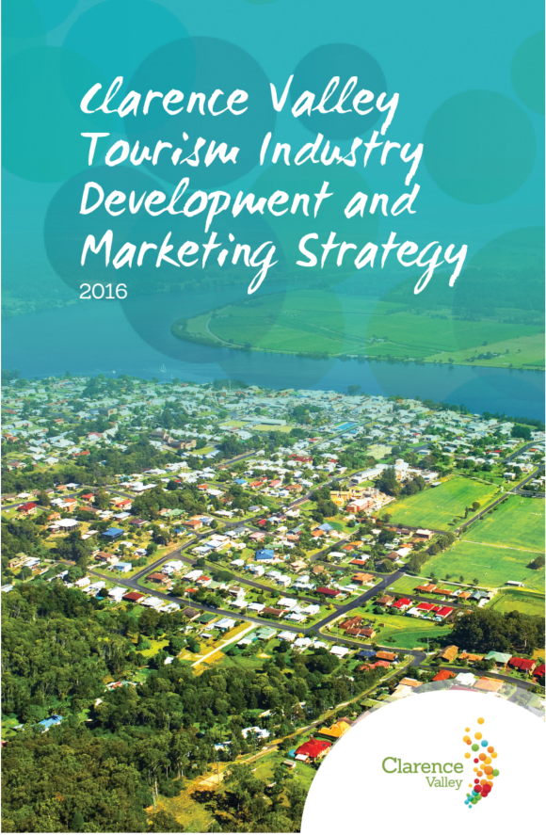
Background and strategies
The Clarence River Master Plan, 2009
The Clarence –River Way Master Plan II, 2021
Adopted by Council Aug 2021
Strategic action plan to guide tourism and investment out to 2031.
Clarence Valley Tourism Service Review, 2013
Clarence Valley Tourism Brand Review and Brand Guidelines (Destination Marketing Store 2014-15)
Clarence Valley Tourism Industry Development and marketing Strategy, 2016
Notes:
Since the original Master Plan was adopted in 2009, it has been used to generate funding and guide strategic development initiatives along the Clarence River and in its towns and villages. Many of the actions of the original Master Plan have been implemented, in particular those focused around the lower reaches of the river and associated towns and villages.
The new Clarence - River Way Master Plan II reviews the social and environmental factors that have changed in the last 10 years, both in the physical environment and for the people who live, work and visit the Clarence region. There is an acknowledgement of the initiatives that have been implemented
and to what degree. The Clarence - River Way Master Plan II provides an up-to-date strategic action plan to guide tourism policy and investment in
the region.

Slide 9
Clarence Valley Tourism Service Review, 2013
Key findings
Significant deficiencies were identified which included:
Inadequate destination marketing.
Disengaged industry.
No suitable brand.
Little commissionable product.
Need for improved signage and interpretation.
Minimal embrace of technology driving modern consumer decisions.
In addition it was identified that:
“Visitor Information Centres (VICs) had minimal impact due to lack of industry interaction and technology embrace. This represented a poor return on the Council’s $737K pa investment which included $496K in VIC support costs.
The VICs had seen a 40% decline in visitation over the previous decade with only 4.4% of visitors using the services

Slide 10
Clarence Valley Tourism Industry Development and marketing Strategy, 2016
A new approach
This new strategy provided a 4 year framework out to the end of 2020.
The strategy identified the target market to be “active families” which was a departure from the “experience seekers” identified in the CV River Way Master Plan.
The most effective means to reach this market was through the internet and social media channels vs brochure and print media. This made the establishment of a strong online brand and website essential.
The active families market conducted over 70% of its travel and accommodation research via the internet and social media.

Slide 11
Clarence Valley Tourism Industry Development and marketing Strategy, 2016
This strategy set the following four goals
Unify, train and enable the local tourism industry.
  Industry Engagement newsletter, workshops/networking events, Business Chamber meetings, Tourism newsletter, My Clarence Valley website and Social media platforms.
Develop experience delivering happiness and shared memories.
  Jacaranda season, Illuminate project, relationship building with media and marketing agencies (DNSW and DNC).
Leverage infrastructure projects for tourism relocation growth.
  Establishment of the My Clarence Valley brand, Welcome information hubs (self-service) and the Visitor Information Centre at Grafton Regional Gallery (live chat, phone and online services).
Assist the local tourism industry reach the national average occupancy rate.

Slide 12
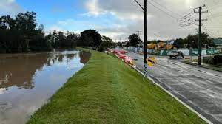
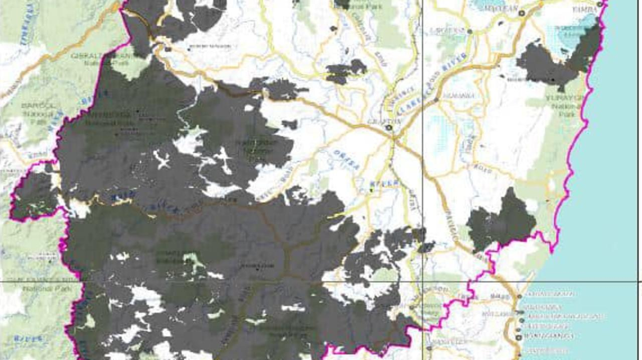
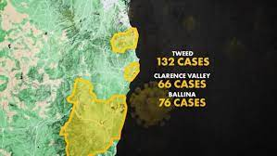
Environmental impacts
Wild Bushfires 2019/2020
Covid-19 March 2020 to December 2021
Floods March 2021
Floods February/March 2022

Slide 13
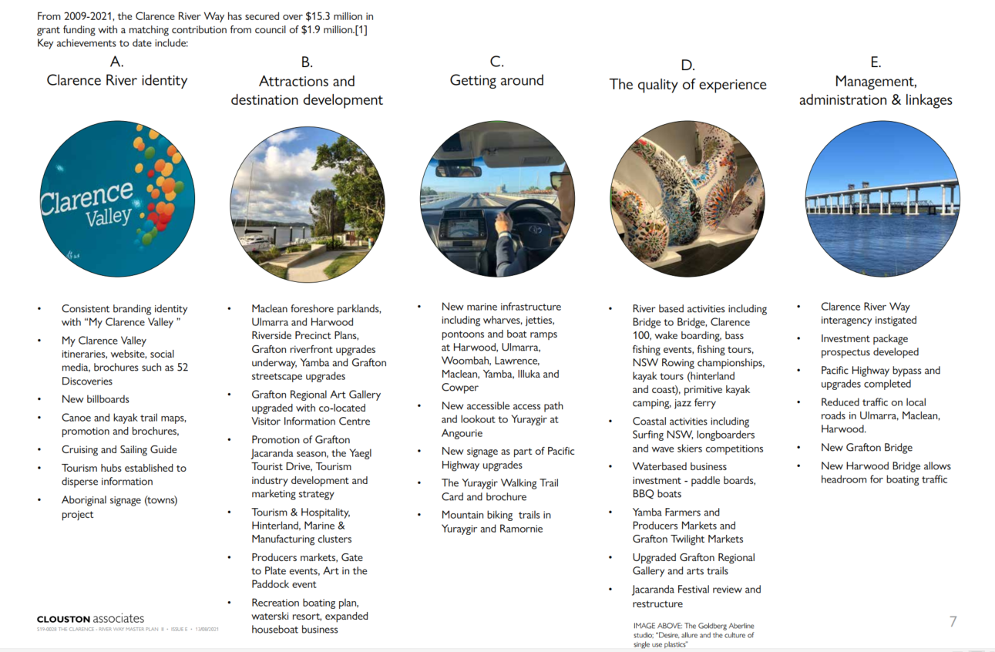
Achievements as of Aug 2021
Notes:
Consistent branding identity with “My Clarence Valley ”
New billboards
Canoe and kayak trail maps, promotion and brochures,
Cruising and Sailing Guide
Tourism hubs established to disperse information
Aboriginal signage (towns) project
Maclean foreshore parklands, Ulmarra and Harwood Riverside Precinct Plans, Grafton riverfront upgrades underway, Yamba and Grafton streetscape upgrades
Grafton Regional Art Gallery upgraded with co-located Visitor Information Centre
Promotion of Grafton Jacaranda season.
New marine infrastructure including wharves, jetties, pontoons and boat ramps at Harwood, Ulmarra, Woombah, Lawrence, Maclean, Yamba, Illuka and cowper
New accessible access path and lookout to Yuraygir at Angourie
New signage as part of Pacific Highway upgrades
River based activities including Bridge to Bridge, Clarence 100, wake boarding, bass fishing events, fishing tours, NSW Rowing championships, kayak tours (hinterland and coast), primitive kayak camping, jazz ferry
Coastal activities including Surfing NSW, longboarders and wave skiers competitions • Waterbased business investment - paddle boards, BBQ boats
Yamba Farmers and Producers Markets and Grafton Twilight Markets
Upgraded Grafton Regional Gallery and arts trails
Jacaranda Season.

Slide 14
Economic Development
Project Initiatives
Load local love
Small Business Month
Dark Sky
Shared Street Spaces
Memorial Park and River Activation
Sector Engagement
Business Chambers (Yamba, Maclean, Grafton)
Regional Development Australia
CVC Planning and Projects

Slide 15
Visitor Information Centre (VIC) data
Accredited Grafton Visitor Information Centre located within the Grafton Regional Gallery shop.
Website & Socials
Year | Phone Calls | Emails | In Person | Notes
FY 18-19 | 1475 | 434 | 5086
FY 19-20 | 997 | 402 | 4320 | COVID - Stats for In Person Other go until January 2020
FY 20-21 | 511 | 113 | 2036 | COVID - Stats for In Person Other starting January 2021
Q1 & Q2 of FY 21-22 | 535 | 491 | 556
Year | Website Views | FB - Followers | FB - Reach | Instagram Followers | Instagram Reach | Social Media Notes
FY 16-17 | 312,658
FY 17-18 | 154,060
FY 18-19 | 145,881
FY 19-20 | 164,034 | 19415 | 437,439 | 10516 | 185,789
FY 20-21 | 202,268 | 30684 | 2,585,303 | 12993 | 755,157
Q1-Q3 of FY 21/22 | 70,633 | 31,966 | 1,576,213 | 14353 | 219,417 | Covid and Floods drastically effected our numbers.

Slide 16
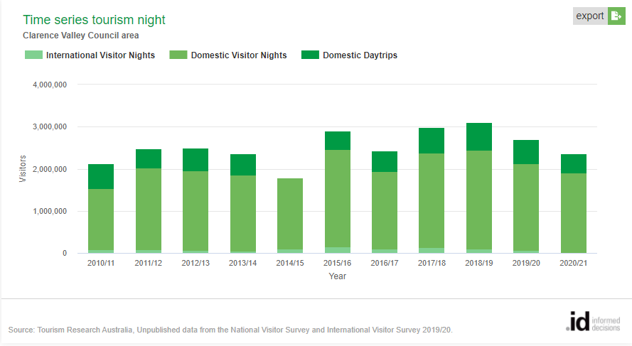
Statistics

Slide 17
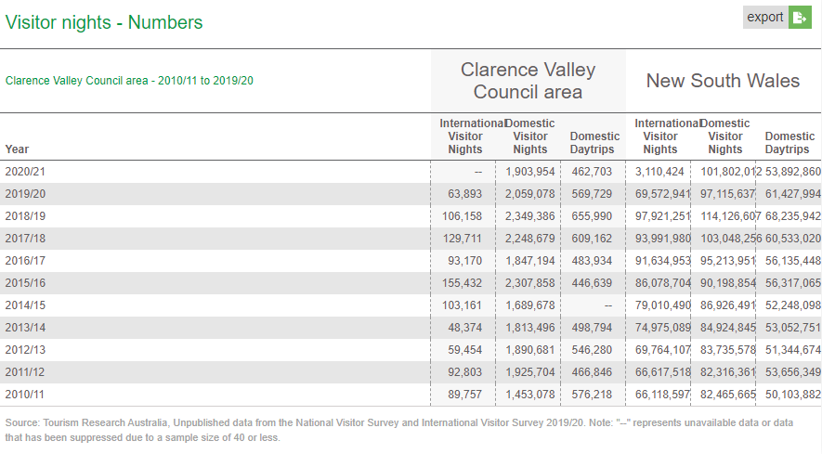
Statistics

