Slide 1
Strategic planning
Clarence Valley
EDTAC Briefing 7 December 2022

Slide 2
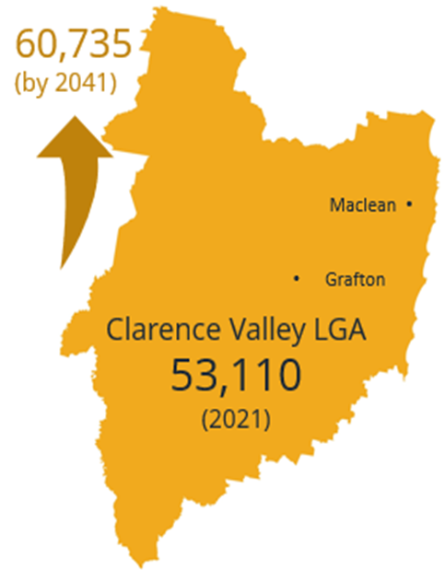
A community of opportunity
Largest LGA in coastal NSW
Enviable lifestyle, amenity and natural environment
Unique assets – river, port, flood free airport, available land, transport links,
Flood free land zoned and available for housing

Slide 3
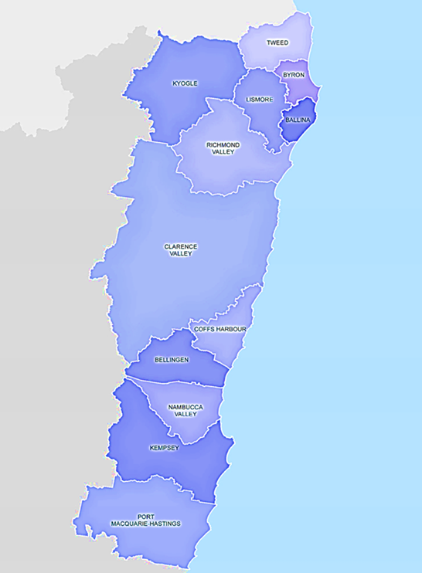
A community of opportunity
Linking council between northern rivers and mid north coast (and links west)
changes and opportunities:
regional population shift
working from home
localism & sustainability
Innovation and emerging industries

Slide 4
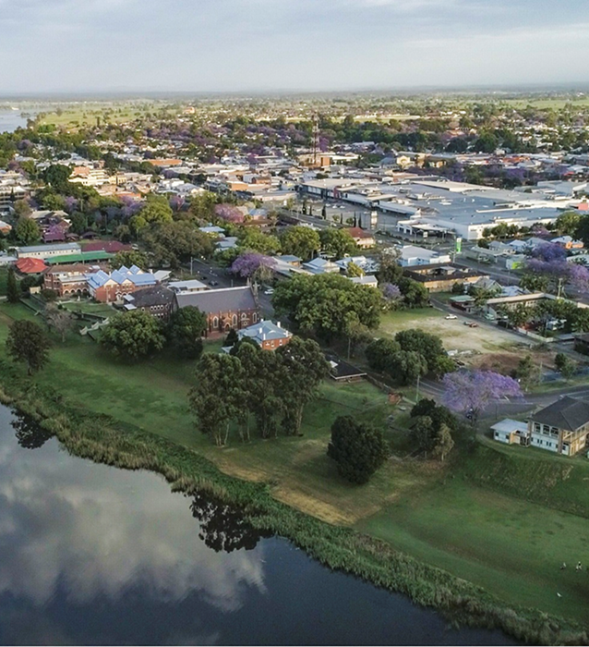
Employment Land Strategy
supports a sub-regional approach to land supply – more industrial land
endorses our approach to make Grafton a successful regional city and the importance of ‘place-making’
provides a focus on “Strategic Infrastructure”
Airport, Health Precinct and old Grafton Gaol, Harwood Marine and Port, new Motorway, distribution centre or intermodal facility, ‘last mile’ freight and logistics
highlights opportunities for Council to take a leadership / concierge role to support business and grow a sustainable local economy

Slide 5
Employment land strategy actions include:
Progress rezoning of South Grafton (Big River Way) Investigation area
Improve road connections and resilience, particularly to strategic infrastructure
Facilitate development of larger lots for Industrial development
Promote ‘placemaking’ and improved amenity (e.g. Grafton CBD Plan)
Attract skilled workers (incl. more housing choice)
Support creative industries and technology
Support agribusiness
Review of height limits in Grafton

Slide 6
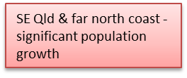
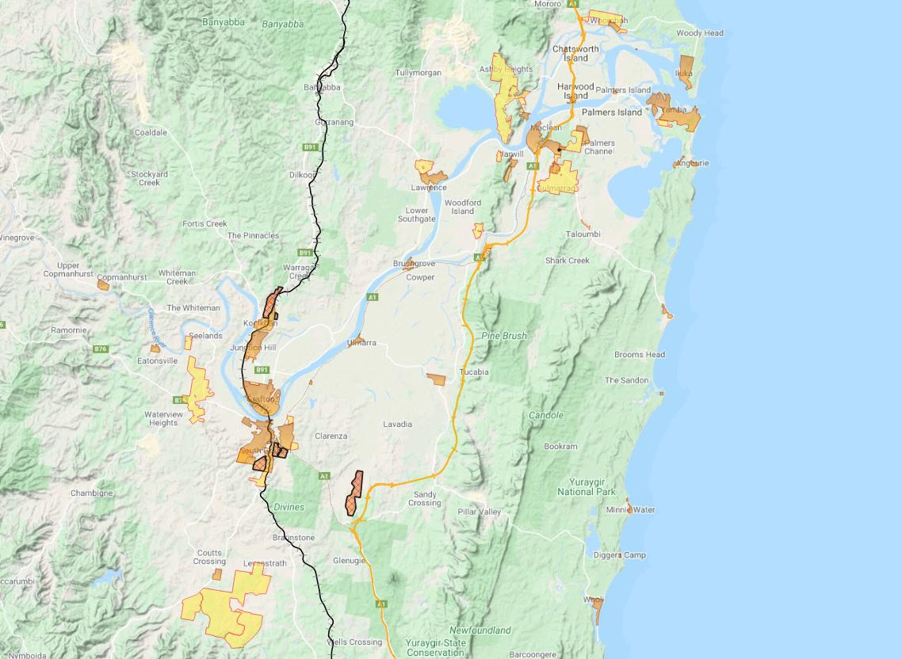
Clarence Valley Employment Land
Existing and for investigation
Iluka – mixed industrial development supported
Working waterfront development where appropriate
Yamba – continue to support appropriate industrial uses
Maclean
Around 1,720ha of potential employment land is flagged for investigation in the North Coast Regional Plan.
Townsend - suitable for employment
Koolkhan
South Grafton (Big River Way)
Grafton
Clarence Correctional Centre – additional 600 jobs
Airport and surrounds
South Grafton (Armidale Rd West)
Coffs Harbour – growing population and some land constraints

Slide 7
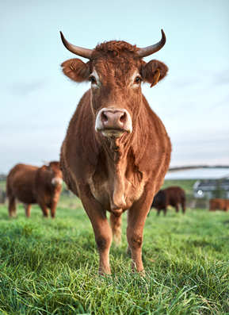
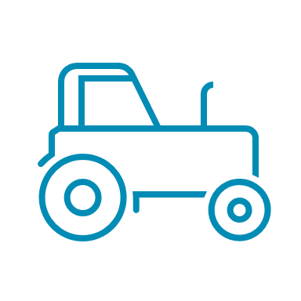
Rural land Strategy
Acknowledge the significant role of rural lands in the economic, social and environmental fabric of Clarence Valley
69%
of Clarence Valley land is within a Rural “RU” zone
$430m
Clarence Valley agriculture, forestry and fishing output in 2020/21
Priorities include:
Sustainable Agriculture officer
Improve resilience and supply chains (bushfire, floods etc.)
Renewed focus on biodiversity & Env. outcomes

